Slide 1
Overview of Convergent Plate Boundaries

Slide 2
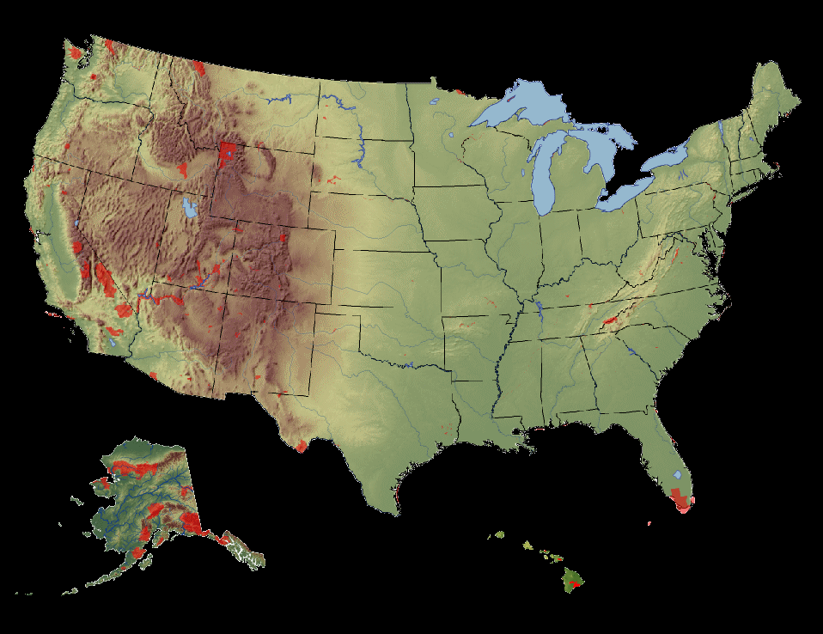
ACTIVE
Olympic
Rainier
Crater Lake
Redwood
Lassen

Slide 3
ACTIVE
Lake Clark
Kenai Fjords
Katmai

Slide 4
ANCIENT
Yosemite
Kings Canyon
Sequoia

Slide 5
ANCIENT
Acadia
Shenandoah
Great Smoky

Slide 6
ANCIENT
Hot Springs
Big Bend

Slide 7
Convergence Types:
1. Ocean-Ocean
2. Continent-Continent
3. Ocean-Continent

Slide 8
1. Ocean-Ocean

Slide 9
2. Continent-Continent

Slide 10
DCM
3. Ocean-Continent

Slide 11
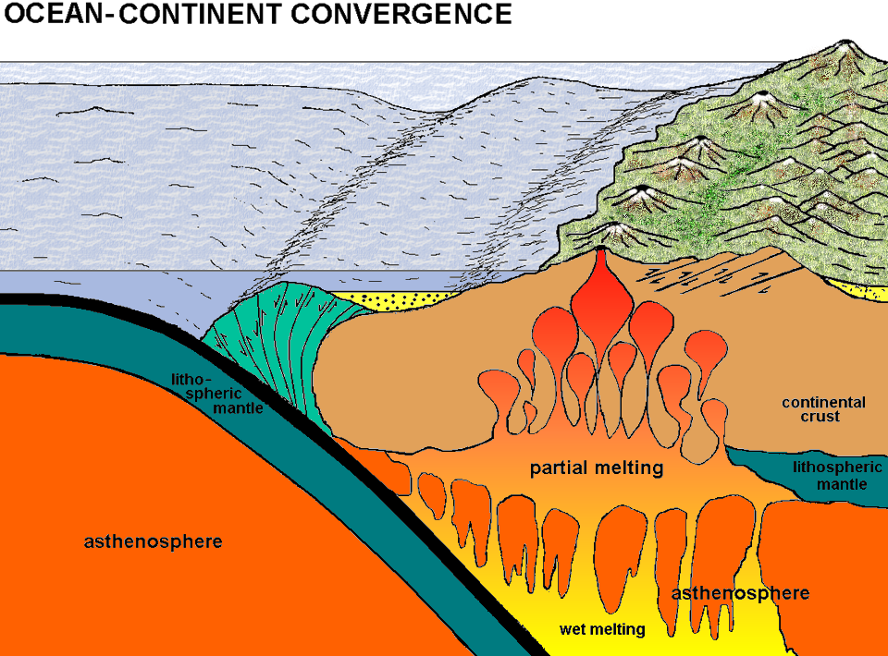
Ocean continent convergence

Slide 12
Ocean continent convergence
T R E N C H

Slide 13
Ocean continent convergence
T R E N C H
H₂O

Slide 14
Ocean continent convergence
VOLCANIC ARC (andesite)
T R E N C H

Slide 15
Figure 17.14

Slide 16
Ocean continent convergence
VOLCANIC ARC (andesite)
ACCRETIONARY WEDGE
T R E N C H

Slide 17
Ocean continent convergence
VOLCANIC ARC (andesite)
ACCRETIONARY WEDGE
T R E N C H
+/- TERRANES

Slide 18
Figure 17.16a

Slide 21
Figure 17.17

Slide 22
Ocean continent convergence
VOLCANIC ARC (andesite)
ACCRETIONARY WEDGE
FOREARC BASIN
T R E N C H
+/- TERRANES

Slide 23
Ocean continent convergence
VOLCANIC ARC (andesite)
FORELAND FOLD & THRUST BELT
ACCRETIONARY WEDGE
FOREARC BASIN
T R E N C H
+/- TERRANES

Slide 24
Ocean continent convergence
VOLCANIC ARC (andesite)
FORELAND FOLD & THRUST BELT
ACCRETIONARY WEDGE
FOREARC BASIN
T R E N C H
+/- TERRANES
FORELAND BASIN

Slide 25
Ocean continent convergence
VOLCANIC ARC (andesite)
FORELAND FOLD & THRUST BELT
ACCRETIONARY WEDGE
FOREARC BASIN
T R E N C H
+/- TERRANES
FORELAND BASIN

Slide 26
ACCRETIONARY WEDGES
Olympic
Redwood
Kenai Fjords

Slide 27
COMPARISON OF ACCRETIONARY WEDGES
PARK | AGE | SUBDUCTION RATE | SEDIMENATION RATE | COMPOSITION | COASTAL LANDFORMS
OLYMPIC | YOUNG | SLOW | HIGHEST | Turbidite, basalt, limestone, quartz veins | Marine terraces, stacks, arches, tombolos
REDWOOD | OLD | SLOW | HIGHER | MELANGE: (basalt, peridotite, chert, greywacke, argillite) | Marine terraces, stacks, arches, tombolos, drowned river valleys
KENAI FJORDS | MIDDLE | MODERATE | HIGH | HIGH Ophiolite, granite, mélange | Fjords, stacks, arches

